Slide 1


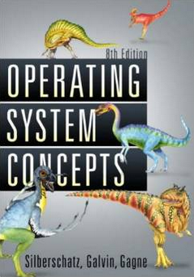
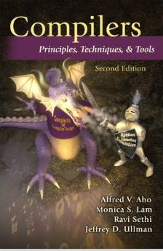

Necessity of Automated SW Analysis - Fight the Complexity of SW
Moonzoo Kim

Slide 2


SW Testing is Very Complex and Difficult Task
The ratio of time spent for developing and testing SW products is 1:3
“… We have as many testers as we have developers. Testers basically test all the time, and developers basically are involved in the testing process about half the time…”
The ratio of program code written for SW products and test harness is 1:3
“…The test cases are unbelievably expensive; in fact, there's more lines of code in the test harness than there is in the program itself. Often that's a ratio of about three to one.”
Object-Oriented Programming, Systems Languages, and Applications, Seattle, Washington, 2002

Slide 3
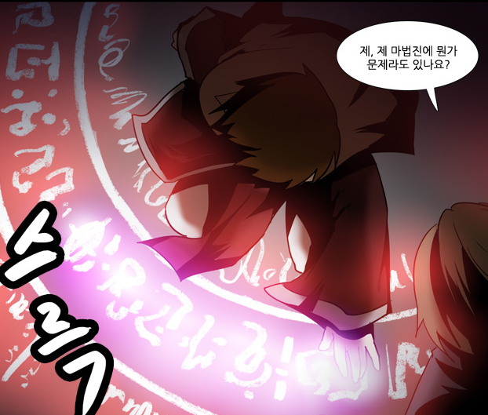

Software v.s. Magic Circle (마법진)
Written by a software developers line by line
Requires programming expertise
SW executes complicated tasks which are far more complex than the code itself
The software often behaves in unpredicted ways and crash occurs
Written by a human magician line by line
Requires magic spell knowledge
Summoned monsters are far more powerful than the magic spell itself
The summoned demon is often uncontrollable and disaster occurs
네이버 웹툰 “그 판타지 세계에서 사는법“ by 촌장

Slide 4
Summary: What is (the essense of) Software?
Software = a large state transition system
SW testing = to find a state (or an execution, or a sub-tree of executions) that violates a given requirement among the large state transition system
A human brain is poor at enumerating all states of a target SW, but computer is good at the task
Automated SW verification = to enumerate and analyze the states (or executions, or a tree of executions) of SW systematically (and exhaustively if possible)

Slide 5
Operational Semantics of Software
σ₁
σ₂
σ₃
x:0,y:0
A system has its semantics as a set of system executions σ’s
A system execution σ is a sequence of states s₀s₁…
A state has an environment ρ_{s}:Var-> Val
s₀
x:0,y:1
s₁
x:1,y:2
x:5,y:1
s₂
s₁₁
x:1,y:3
x:5,y:2
s₃
s₁₂
x:2,y:4
x:5,y:3
x:7,y:3
s₄
s₁₃
s₂₁
x:5,y:4
x:7,y:4
s₁₄
s₂₂

Slide 6
Example
active type A() {
byte x;
again:
x=x+1;;
goto again;
}
x:0
x:1
x:2
x:255
active type A() {
byte x;
again:
x=x+1;;
goto again;
}
active type B() {
byte y;
again:
y++;
goto again;
}
x:0,y:0
x:0,y:1
x:0,y:255
x:1,y:0
x:1,y:1
x:1,y:255
x:2,y:0
x:2,y:1
x:2,y:255
x:255,y:0
x:255,y:255
Note that model checking analyzes ALL possible execution scenarios while testing analyzes SOME execution scenarios

Slide 7
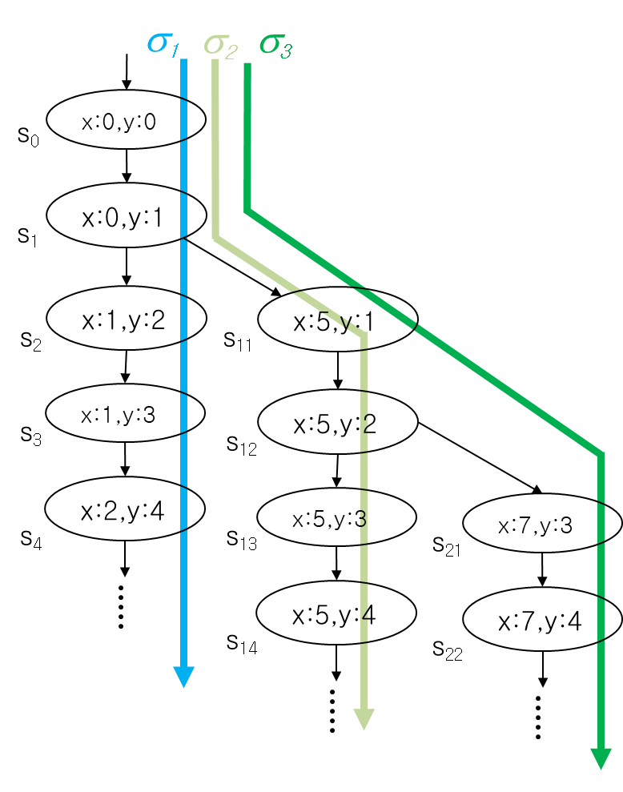
Bug Detection vs. Verification
Bug detection (testing):
a given assert statement (at a given code location) is violated
proof: for a some execution like σ₁, a given assert is violated
ex. σ₁ violates the assert( 2x != y) at s_{0 ,} s_{2 ,}and s₄
Verification (model checking):
a given assert statement will be never violated (i.e., always satisfied)
proof: for every possible execution σ₁, σ₂, σ₃, and so on, a given assert is satisfied
ex. there is no execution σ such that assert( x >= 0) is violated.

Slide 8
Verification: State Exploration Method
Model checking
Generate possible states from the model/program and then check whether given requirement properties are satisfied within the state space
On-the-fly v.s. generates all
Symbolic states v.s. explicit state
Model based v.s. code based
System
model
OK
Model Checking
(state exploration)
or
Requirement
properties
Counter
example
(Φ Ω)

Slide 9
Pros and Cons of Model Checking
Pros
Fully automated and provide complete coverage
Concrete counter examples
Full control over every detail of system behavior
Highly effective for analyzing
embedded software
multi-threaded systems
Cons
State explosion problem
An abstracted model may not fully reflect a real system
Needs to use a specialized modeling language
Modeling languages are similar to programming languages, but simpler and clearer

Slide 10



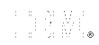






Companies Working on Model Checking

Slide 11
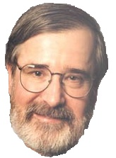
Early Model Checking History
1981 Clarke / Emerson: CTL Model Checking Sifakis / Quielle
1982 EMC: Explicit Model Checker Clarke, Emerson, Sistla
1990 Symbolic Model Checking
Burch, Clarke, Dill, McMillan
SMV: Symbolic Model Verifier
McMillan
1998 Bounded Model Checking using SAT
Biere, Clarke, Zhu
2000 Counterexample-guided Abstraction Refinement
Clarke, Grumberg, Jha, Lu, Veith
10⁵
10¹⁰⁰
10¹⁰⁰⁰

Slide 12

Software Development Cycle
A practical end-to-end formal framework for software development
A SW Development Framework for SW with High Assurance
Requirement
analysis
System
design
Design
analysis
Implement-
ation
Testing
Monitoring
Formal
require-
ment
Spec.
Formal
system
modeling
Model
analysis/
verification
Model-
assisted
code
generation
Model-
based
testing
Runtime
monitoring
and
checking

Slide 13
Requirement Specification Problems
Ambiguity
Expression does not have unique meaning, but can be interpreted as several different meaning.
Ex. For a natural number input, do X
What if a 0 is given? Is 0 a natural number?
Incompleteness
Relevant issues are not addressed , e.g. what to do when user errors occur or software faults show.
Ex. For a positive integer input, do Y
What if a negative input is given?
Inconsistency
Contradictory requirements in different parts of the specification.
Ex. For a non-negative input, execute Z, and for a non-positive input, do not execute Z
What if 0 is given?

Slide 14
Example (retail chain management software)
If the sales for the current month are below the target sales, then a report is to be printed,
unless the difference between target sales and actual sales is less than half of the difference between target sales and actual sales in the previous month
or if the difference between target sales and actual sales for the current month is under 5 percent.

Slide 15
Example 2: Leap year (윤년) detection
The Februray of a leap year has 29th day (i.e., an extra day).
Given year, print “Leap year” if the following conditions hold:
a) if a year is divisible by 4, it is a leap year. Otherwise, it is not.
b) if a year is divisible by both 4 and 100, it is not a leap year.
c) if a year is divisible by 400, it is a leap year.
예시:
isLeapYear(2008)
isLeapYear(2100)
isLeapYear(2021)
isLeapYear(2000)
Leap year
Not a leap year
Not a leap year
Leap year
Notes:
def isLeapYear(year):
if (year % 4 == 0 and year % 100 != 0 ) or (year % 400 == 0) :
print ("윤년")
else :
print ("평년")

Slide 16
Necessity of Rigorous Req. Spec.
Specifications in natural language (ex. 한국어, English, 日本語, etc) can be easily ambiguous, inconsistent, and incomplete
Also, connectives in natural languages can have several meaning
John eats an apple and Mary eats an orange
John drove on and hit Mary
The sun is shining and John feels happy
John is a Korean or a computer scientist
John is working or he is at home
“and” may have an ordering information in time
“and” may indicate a cause and result
“or” may have an exclusive meaning

Slide 17
Ex. Testing a Triangle Decision Program
Input : Read three integer values from the command line. The three values represent the length of the sides of a triangle.
Output : Tell whether the triangle is
• Scalene (부등변삼각형 ) : no two sides are equal
• Isosceles (이등변삼각형) : exactly two sides are equal
• Equilateral(정삼각형) : all sides are equal
Create a Set of Test Cases for this program
(3,4,5), (2,2,1), (1,1,1) ?

Slide 18
Precondition (Input Validity) Check
Condition 1: a > 0, b > 0, c > 0
Condition 2: a < b + c
Ex. (4, 2, 1) is an invalid triangle
Permutation of the above condition
a < b +c
b < a + c
c < a + b
What if b + c exceeds 2³² (i.e. overflow)?
long v.s. int v.s. short. v.s. char
Developers often fail to consider implicit preconditions
Cause of many hard-to-find bugs

Slide 19
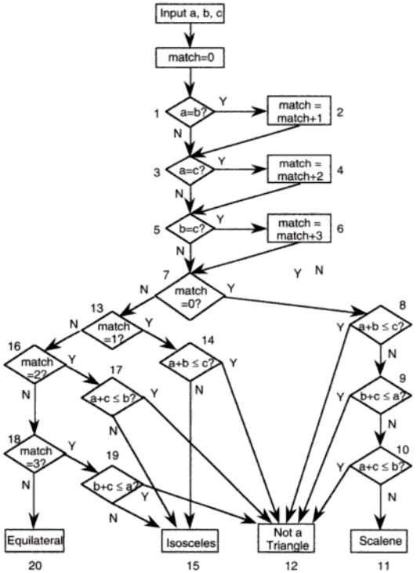
Test Cases for the Triangle Decision
int triangle(int a, int b, int c) {
int match=0, result=-1;
1: if(a==b) match=match+1;
3: if(a==c) match=match+2;
5: if(b==c) match=match+3;
7: if(match==0) {
8: if( a+b <= c) result=2;
9: else if( b+c <= a) result=2;
10: else if(a+c <= b) result =2;
else result=3;
} else {
13: if(match == 1) {
14: if(a+b <= c) result =2;
else result=1;
} else {
16: if(match ==2) {
17: if(a+c <=b) result = 2;
else result=1;
} else {
18: if(match==3) {
19: if(b+c <= a) result=2;
else result=1;
} else result = 0;
} }}
return result; }
“Software Testing a craftsman’s approach” 2nd ed by P.C.Jorgensen
Notes:
int triangle(int a, int b, int c) {
int match=0, result=-1;
if(a==b) match=match+1;
if(a==c) match=match+2;
if(b==c) match=match+3;
if(match==0) {
if( a+b <= c) result=2;
else if( b+c <= a) result=2;
else if(a+c <= b) result =2;
else result=3;
} else {
if(match == 1) {
if(a+b <= c) result =2;
else result=1;
} else {
if(match ==2) {
if(a+c <=b) result = 2;
else result=1;
} else {
if(match==3) {
if(b+c <= a) result=2;
else result=1;
} else result = 0;
} }}
return result; }

Slide 20
Test Cases for the Triangle Decision
“Software Testing a craftsman’s approach” 2nd ed by P.C.Jorgensen
# of test cases required?
4
11
50
100
# of feasible unique execution paths?
11
The goal of testing
Generate 11 test cases that exercise the 11 unique execution paths

Slide 21
Test Cases for the Triangle Decision
a,b,c = 1,1,1:match=6:result=0:p1
a,b,c = 3,2,2:match=3:result=1:p2
a,b,c = 2,1,2:match=2:result=1:p3
a,b,c = 2,2,1:match=1:result=1:p4
a,b,c = 2,1,1:match=3:result=2:p5
a,b,c = 1,2,1:match=2:result=2:p6
a,b,c = 1,1,2:match=1:result=2:p7
a,b,c = 2,1,3:match=0:result=2:p8
a,b,c = 3,2,1:match=0:result=2:p9
a,b,c = 2,3,1:match=0:result=2:p10
a,b,c = 4,3,2:match=0:result=3:p11
“Software Testing a craftsman’s approach” 2nd ed by P.C.Jorgensen
3
8
6
7
9
1
4
11
2
5
10
Notes:
a,b,c = 1,1,1:match=6:result=0:p1
a,b,c = 3,2,2:match=3:result=1:p2
a,b,c = 2,1,2:match=2:result=1:p3
a,b,c = 2,2,1:match=1:result=1:p4
a,b,c = 2,1,1:match=3:result=2:p5
a,b,c = 1,2,1:match=2:result=2:p6
a,b,c = 1,1,2:match=1:result=2:p7
a,b,c = 2,1,3:match=0:result=2:p8
a,b,c = 3,2,1:match=0:result=2:p9
a,b,c = 2,3,1:match=0:result=2:p10
a,b,c = 4,3,2:match=0:result=3:p11

Slide 22
Test Cases for the Triangle Decision
a) a≠b /\ a≠c /\ b≠c (match=0)
b) a=b /\ a≠c /\ b≠c (match=1)
c) a≠b /\ a=c /\ b≠c (match=2)
d) a≠b /\ a≠c /\ b=c (match=3)
e) a=b /\ a=c /\ b=c (match=6)
“Software Testing a craftsman’s approach” 2nd ed by P.C.Jorgensen
Cartesian product
1) match≠0 /\ match≠1 /\ match≠2 /\ match≠3 (EQ)
2) match≠0 /\ match≠1 /\ match≠2 /\ match=3
/\ b+c > a (ISO)
3) match≠0 /\ match≠1 /\ match≠2 /\ match=3
/\ b+c ≤ a (NTR)
4) match≠0 /\ match≠1 /\ match=2 /\ a+c > b (ISO)
5) match≠0 /\ match≠1 /\ match=2 /\ a+c ≤ b (NTR)
6) match≠0 /\ match=1 /\ a+b > c (ISO)
7) match≠0 /\ match=1 /\ a+b ≤ c (NTR)
8) match=0 /\ a+b ≤ c (NTR)
9) match=0 /\ a+b > c /\ b+c ≤ a (NTR)
10) match=0 /\ a+b > c /\ b+c > a /\ a+c ≤ b (NTR)
11) match=0 /\ a+b > c /\ b+c > a /\ a+c > b (SCL)
3
8
6
7
9
1
4
11
2
5
10
Notes:
a,b,c = 1,1,1:match=6:result=0:p1
a,b,c = 3,2,2:match=3:result=1:p2
a,b,c = 2,1,2:match=2:result=1:p3
a,b,c = 2,2,1:match=1:result=1:p4
a,b,c = 2,1,1:match=3:result=2:p5
a,b,c = 1,2,1:match=2:result=2:p6
a,b,c = 1,1,2:match=1:result=2:p7
a,b,c = 2,1,3:match=0:result=2:p8
a,b,c = 3,2,1:match=0:result=2:p9
a,b,c = 2,3,1:match=0:result=2:p10
a,b,c = 4,3,2:match=0:result=3:p11

Slide 23
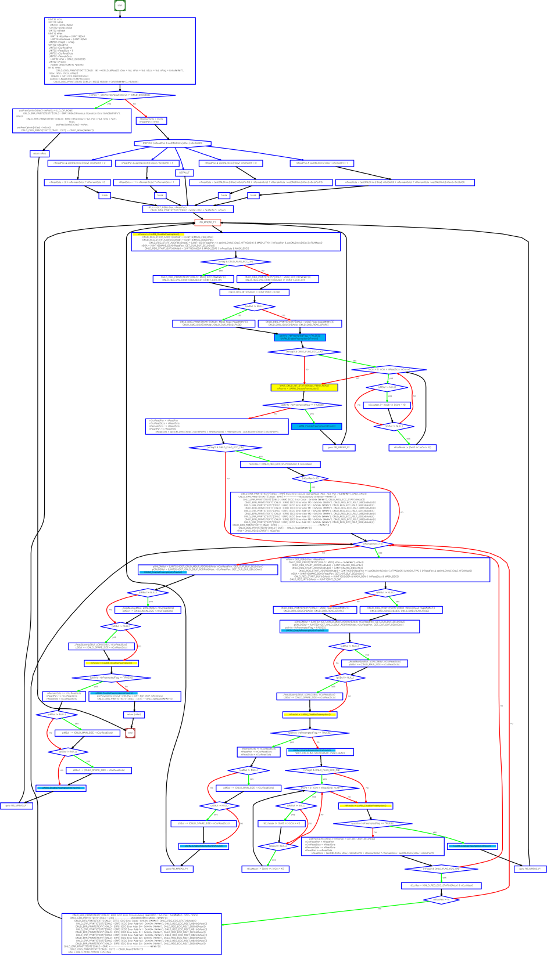
Test Cases for the Triangle Decision
# of test cases required?
4
11
50
100
# of feasible unique execution paths?
11
The goal of testing
Generate 11 test cases that exercise the 11 unique execution paths
“Software Testing a craftsman’s approach” 2nd ed by P.C.Jorgensen

Slide 24
More Complex Testing Situations (1/3)
Software is constantly changing
What if “integer value” is relaxed to “floating value” ?
Round-off errors should be handled explicitly
What if new statements S₁ … S_{n} are added to check whether the given triangle is a right angle triangle (직각삼각형)?
Will you test all previous tests again?
How to create minimal test cases to check the changed parts of the target program

Slide 25
More Complex Testing Situations (2/3)
Regression testing is essential
How to select statements/conditions affected by the revision of the program?
How to create test cases to cover those statements/conditions?
How to create efficient test cases?
How to create a minimal set of test cases (i.e. # of test cases is small)?
How to create a minimal test case (i.e. causing minimal execution time)?
How to reuse pre-existing test cases?

Slide 26
More Complex Testing Situations (3/3)
However, conventional coverage is not complete
Ex. int adder(int x, int y) { return 3;}
Test case (x=1,y=2) covers all statements/branches of the target program and detects no error
In other words, all variable values must be explored for complete results
Formal verification aims to guarantee completeness
Model checking analyzes all possible x, y values through 2⁶⁴ (=2³² x 2³²) cases
However, model checking is more popular for debugging, not verification

Slide 27
Concurrency
Concurrent programs have very high complexity
due to non-deterministic scheduling
Ex. int x=0, y=0, z =0;
void Thread1() {x=y+1; y=z+1; z= x+1;}
Void Thread2() {y=z+1; z=x+1; x=y+1;}
Total 20 interleaving scenarios
= (3+3)!/(3!x3!)
However, only 11 unique outcomes
assert(x+y+z > 5)???
assert(x+y+z < 15)???
Thread1()
x=y+1
y=z+1
z=x+1
Thread2()
y=z+1
z=x+1
x=y+1
Trail1: 2,1,2
Trail2: 2,1,3
Trail3: 2,2,3
Trail4: 2,3,3
Trail5: 2,4,3
Trail6: 3,2,3
Trail7: 3,2,4
Trail8: 4,3,2
Trail9: 4,3,5
Trail10: 5,4,3
Trail11: 5,4,6

Slide 28
An Example of Mutual Exclusion Protocol
char cnt=0,x=0,y=0,z=0;
void process() {
char me=_pid +1; /* me is 1 or 2*/
again:
x = me;
If (y ==0 || y== me) ;
else goto again;
z =me;
If (x == me) ;
else goto again;
y=me;
If(z==me);
else goto again;
/* enter critical section */
cnt++;
assert( cnt ==1);
cnt --;
goto again;
}
Process 0
x = 1
If(y==0 || y == 1)
z = 1
If(x == 1)
y = 1
If(z == 1)
cnt++
Process 1
x = 2
If(y==0 || y ==2)
z = 2
If(x==2)
y=2
If (z==2)
cnt++
Software
locks
Critical
section
Violation detected !!!
Mutual
Exclusion
Algorithm
Counter
Example

Slide 29


Static SW Code vs. Dynamic SW Executions
Thread1()
x=y+1
y=z+1
z=x+1
Thread2()
int x=0, y=0, z =0;
void Thread1() {x=y+1; y=z+1; z= x+1;}
void Thread2() {y=z+1; z=x+1; x=y+1;}
y=z+1
z=x+1
x=y+1

Slide 30
More Concurrency Bugs
Data race bugs
Atomicity bugs
class Account_DR {
double balance;
// INV:balance should be always non-negative
void withdraw(double x) {
1: if (balance >= x) {
2: balance = balance–x;}
...
}}
class Account_BR {
Lock m;
double balance;
// INV: balance should be non-negative
double getBalance() {
double tmp;
1: lock(m);
2: tmp = balance ;
3: unlock(m);
4: return tmp; }
void withdraw(double x){
/*@atomic region begins*/
11: if (getBalance() >= x){
12: lock(m);
13: balance = balance – x;
14: unlock(m); }
/*@atomic region ends*/
... }
(a) Buggy program code
(a) Buggy program code
[Initially, balance:10]
-th1: withdraw(10)-
1: if(balance >= 10)
2: balance = 0 – 10;
-th2: withdraw(10)-
1: if(balance >= 10)
2: balance = 10-10;
[Initially, balance:10 ]
-th1: withdraw(10)-
11:if(getBalance()>=10)
getBalance()
1:lock(m);
2:tmp = balance;
3:unlock(m);
4:return tmp;
12: lock(m);
13: balance=0 – 10;
14: unlock(m);
-th2 : withdraw(10)-
...
12: lock(m);
13: balance=10–10;
14: unlock(m);
operation block b_{i}
The invariant is violated as
balance becomes -10.
The invariant is violated as
balance becomes -10.
(b) Erroneous execution
(b) Erroneous execution

Slide 31

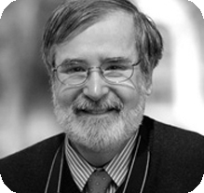
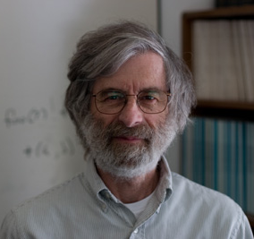
Formal Analysis of Software
2007 ACM Turing Awardees
Prof. Edmund Clarke, Dr. Joseph Sipfakis, Prof. E. Allen Emerson
For the contribution of migrating from pure model checking research to industrial reality
2013 ACM Turing Awardee
Dr. Leslie Lamport
For fundamental contributions to the theory and practice of distributed and concurrent systems
Happens-before relation, sequential consistency, Bakery algorithm, TLA+, and LaTeX

Slide 32
An Example of a Provable Stmt and a True Stmt
Four derivation rules
ϕ | Ã | ϕ ∧ Ã ! Ã ∧ ϕ
T | T | T
T | F | T
F | T | T
F | F | T
assumption
Proof
- Syntactic method
- Derivation
Validity
- Semantic method
- Valuation

Slide 33
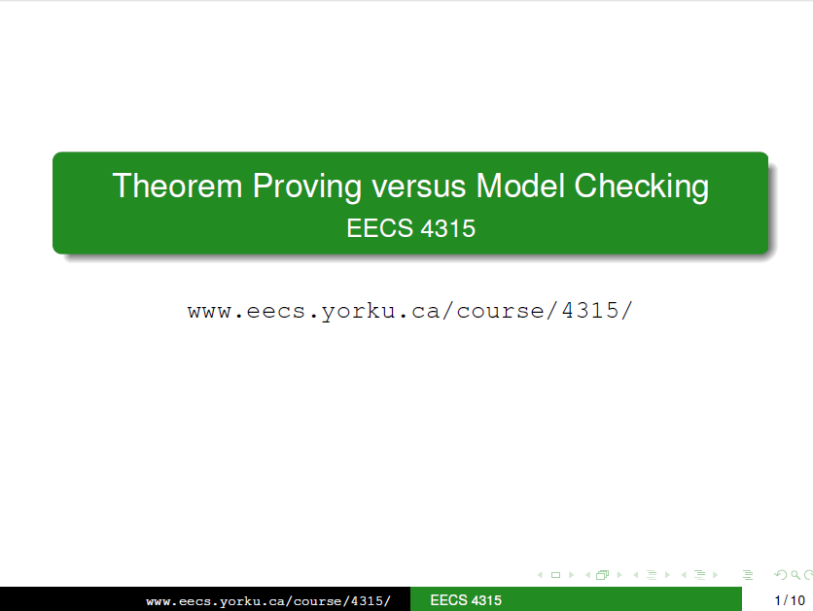
Model Checking vs. Theorem Proving
In model checking,
you describe an abstracted version of your system and you can automatically check some properties.
Your model has to be small enough (in term of number of states) to be processed by the tool, and the class of formulas you can express may be limited.
Typically, you can check safety properties (such as assert statement in your code).
In theorem proving (a.k.a., proof assistant),
programs are typically verified method-by-method.
Given a method and its contract, a theorem prover transforms the precondition while symbolically executing the method.
Then, it checks whether the transformed precondition is a model of the postcondition (i.e., it implies the postcondition).

Slide 34
Model Checking vs. Theorem Proving
In model checking,
Model checking, roughly, tries to use brute force to answer the question and requires no human interaction in doing so. You could imagine it feeding every possible input to every process, choosing every possible interleaving of messages and, for every state reachable in such a manner, checking whether the bad thing happens.
In theorem proving (a.k.a., proof assistant),
you try to provide the rationale of why things can’t go wrong in form of theorems. However, you also have to convince the theorem prover that your reasoning is sound.
So first you need to understand what methods of reasoning you are using precisely, and you also need to somewhat understand the way of how the prover "ticks" and what kinds of reasoning steps it can perform automatically.

Slide 35




Significance of Formal SW Modeling and Verification
Software has become more ubiquitous and more complex at the same time
Human resources are becoming less reliable and more expensive for highly complex software
Computing resources are becoming ubiquitous and cheap
Amazon AWS price: you can use thousands of CPUs @ 0.03$/hr for 2.5Ghz Quad-core CPU
To-do: Develop scientific SW modeling and verification tools to utilize computing resource effectively and efficiently

Slide 36
Summary: What is (the essense of) Software?
Software = a large state transition system
SW testing = to find a state (or an execution, or a sub-tree of executions) that violates a given requirement among the large state transition system
A human brain is poor at enumerating all states of a target SW, but computer is good at the task
Automated SW verification = to enumerate and analyze the states (or executions, or a tree of executions) of SW systematically (and exhaustively if possible)

